Slide 1
CSE-327 Software Engineering
Md Shakil Ahmed
Lecturer
CSE, BUBT

Slide 2
Reference
Chapter-21 : Software Engineering: A Practitioner’s Approach – Roger S. Pressman (8th Edition)
https://www.geeksforgeeks.org/software-engineering-coupling-and-cohesion/

Slide 3
Software Quality Assurance (SQA)
Software Quality Assurance (SQA) is simply a way to assure quality in the software. It is the set of activities which ensure processes, procedures as well as standards are suitable for the project and implemented correctly.
Software Quality Assurance is a process which works parallel to development of software. It focuses on improving the process of development of software so that problems can be prevented before they become a major issue.
Software Quality Assurance is a kind of Umbrella activity that is applied throughout the software process.

Slide 4
Elements of Software Quality Assurance
Standards
The IEEE, ISO, and other standards organizations have produced a broad array of software engineering standards and related documents.
The job of SQA is to ensure that standards that have been adopted are followed and that all work products conform to them.
Reviews and audits
Technical reviews are a quality control activity performed by software engineers. Their intent is to uncover errors.
Audits are a type of review performed by SQA personnel with the intent of ensuring that quality guidelines are being followed for software engineering work.

Slide 5
Elements of Software Quality Assurance
Testing
Software testing is a quality control function that has one primary goal—to find errors.
The job of SQA is to ensure that testing is properly planned and efficiently conducted.
Error/defect collection and analysis
SQA collects and analyzes error and defect data to better understand how errors are introduced and what software engineering activities are best suited to eliminating them.

Slide 6
Elements of Software Quality Assurance
Change management
Change is one of the most disruptive aspects of any software project. If it is not properly managed, change can lead to confusion, and confusion almost always leads to poor quality.
SQA ensures that adequate change management practices have been instituted.
Vendor management
The job of the SQA organization is to ensure that high-quality software results by suggesting specific quality practices that the vendor should follow (when possible), and incorporating quality mandates as part of any contract with an external vendor

Slide 7
Elements of Software Quality Assurance
Security management
SQA ensures that appropriate process and technology are used to achieve software security.
Risk management
The SQA organization ensures that risk management activities are properly conducted and that risk-related contingency plans have been established.

Slide 8
SQA Tasks
Prepares an SQA plan for a project.
Participates in the development of the project’s software process description.
Reviews software engineering activities to verify compliance with the defined software process.
Audits designated software work products to verify compliance with those defined as part of the software process.
Ensures that deviations in software work and work products are documented and handled according to a documented procedure.
Records any noncompliance and reports to senior management.

Slide 9
Goals, Attributes, and Metrics
The SQA activities described in the preceding section are performed to achieve a set of pragmatic goals:
Requirements quality
SQA must ensure that the software team has properly reviewed the requirements model to achieve a high level of quality.
Design quality
SQA looks for attributes of the design that are indicators of quality.
Code quality
SQA should isolate the attributes that allow a reasonable analysis of the quality of code.
Quality control effectiveness
SQA analyzes the allocation of resources for reviews and testing to assess whether they are being allocated in the most effective manner.

Slide 10
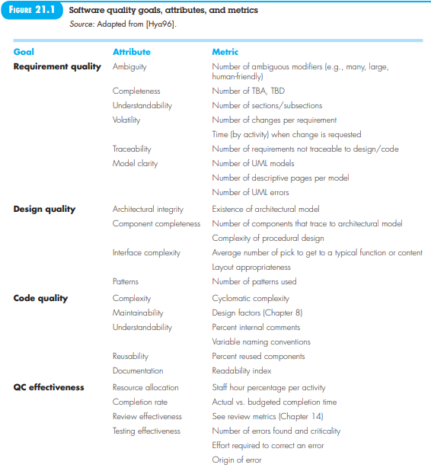

Slide 11
Six Sigma for Software Engineering
Six Sigma is the most widely used strategy for statistical quality assurance in industry today.
Originally popularized by Motorola in the 1980s, the Six Sigma strategy “is a rigorous and disciplined methodology that uses data and statistical analysis to measure and improve a company’s operational performance by identifying and eliminating defects in manufacturing and service-related processes”.

Slide 12
Six Sigma for Software Engineering
The Six Sigma methodology defines three core steps:
Define customer requirements and deliverables and project goals via well-defined methods of customer communication.
Measure the existing process and its output to determine current quality performance (collect defect metrics).
Analyze defect metrics and determine the vital few causes.

Slide 13
Six Sigma for Software Engineering
If an existing software process is in place, but improvement is required, Six Sigma suggests two additional steps:
Improve the process by eliminating the root causes of defects.
Control the process to ensure that future work does not reintroduce the causes of defects.
These core and additional steps are sometimes referred to as the DMAIC (define, measure, analyze, improve, and control) method.

Slide 14
Six Sigma for Software Engineering
If an organization is developing a software process (rather than improving an existing process), the core steps are augmented as follows:
Design the process to (1) avoid the root causes of defects and (2) to meet customer requirements.
Verify that the process model will, in fact, avoid defects and meet customer requirements.
This variation is sometimes called the DMADV (define, measure, analyze, design, and verify) method.

Slide 15
Example of Six Sigma for Existing System
A food delivery company can use the DMAIC methodology to address frequent complaints about late deliveries, which are a primary source of customer dissatisfaction.

Slide 16
Define | Identify the core problem and customer requirements (Critical-To-Quality metrics). | The team defines the defect as "late delivery" (delivery time exceeding the average by more than 10%). The customer expectation is delivery within a certain time window (e.g., 30 minutes).
Measure | Collect data on current delivery performance to establish a baseline. | The team collects data on delivery times, loading times, traffic conditions, and the number of late deliveries. They might find that 50% of complaints are related to late delivery, and the current process is at a low Sigma level.
Analyze | Analyze the data to determine the root causes of delays. | Tools like Pareto charts and fishbone diagrams are used. Root causes are identified as poor warehouse layout, inefficient picking and loading methods, and staff shortages during peak hours.
Improve | Develop and implement solutions to address the root causes. | Solutions might include redesigning the picking area for fast-moving items closer to the loading bay, implementing a "trolley picking" system, and adjusting staff schedules.
Control | Establish controls to ensure the improvements are sustained over time. | The company implements a monitoring system for loading times and customer feedback. Regular audits and performance dashboards are used to maintain the new, faster process and ensure the defect rate remains low.

Slide 17
Example of Six Sigma for New System
When developing a new online food ordering system, the Six Sigma methodology known as DMADV (Define, Measure, Analyze, Design, Verify) is used to ensure quality and customer requirements are met from the ground up, proactively preventing defects.

Slide 18
Define | Identify the purpose, project goals, and customer needs (Voice of the Customer or VOC). | The project team defines the system's goals: "To create a seamless online food ordering experience for university students, reducing wait times at food counters, ensuring order accuracy, and offering diverse menu options". They collect VOC through surveys and interviews to understand specific needs like preferred payment methods, dietary filters, and order tracking.
Measure | Quantify customer needs into measurable Critical-to-Quality (CTQ) characteristics and assess production capabilities and risks. | The team translates VOC into metrics: * Maximum wait time: 10 minutes (CTQ) * Order accuracy: 99.9% (CTQ) * System uptime: 99.99%.
Analyze | Analyze data to develop and evaluate design alternatives and conceptual designs. | The team analyzes options for system architecture, database design, and user interface (UI). They set priority and evaluate alternatives based on cost, risk, and how well they meet the CTQs.
Design | Develop the detailed design and a prototype for the selected solution. | A detailed design for the web/mobile interface, backend logic, and payment integration is created. A prototype is built.
Verify | Validate the design through pilot runs and full production to ensure it meets all requirements and performs satisfactorily in the real environment. | The full system undergoes extensive testing. Performance dashboards and customer feedback mechanisms are implemented to monitor real-time performance. The team ensures the system is stable, scalable, and the initial CTQ targets are met.

Slide 19
W5HH Principles
The W5HH principle is a project planning and management approach proposed by Barry Boehm, aimed at addressing the key questions that should be answered before starting any software project.
W5HH principle: A series of questions that lead to a definition of Project Scope.

Slide 20
Principle | Key Question | Details | Example
Why | Why is it being done? | Clarifies the purpose and goals; links tasks to business or user needs. | Why is a mobile version required? Why prioritize performance?
What | What will be done? | Defines the scope, objectives, tasks, and deliverables of the project. | What features will the system include (e.g., login, reporting)?
When | When will it be done? | Establishes the timeline, deadlines, and schedule of each task. | When will testing begin? When is the delivery date?
Who | Who is responsible? | Identifies roles and responsibilities of team members and stakeholders. | Who will handle database design? Who is the project manager?
Where | Where will it be done? | Determines the physical or virtual location and platform where work is performed. | Will development be done remotely? On which cloud platform?
How | How will it be done? | Specifies the methods, tools, standards, and technologies used. | Using Agile methodology, Java, and MySQL database.
How much | How much will it cost? | Estimates cost, effort, time, and resources required for each phase. | Total development cost is $20,000; needs 4 developers for 3 months.

Slide 21
90-90 Rule & W5HH

Slide 22
90-90 Rule
The Ninety-Ninety Rule is a humorous observation in software development, which states that the first 90% of a project takes 90% of the time, and the remaining 10% also takes 90% of the time.

Slide 23
Key Takeaways
The Ninety-Ninety Rule is a humorous aphorism in software engineering, stating that the first 90% of a project’s code takes 90% of the development time, while the remaining 10% takes the other 90% of the time.
This rule highlights the common issue of underestimating the time required for project completion, as the last 10% of development often involves bug-fixes, optimization, and final adjustments that are unexpectedly time-consuming.
While not a definitive guideline, the Ninety-Ninety Rule serves as a cautionary reminder for project managers and developers to always allocate enough time for the final stages of development to ensure overall project success.

